Slide 1
jQuery

Slide 2

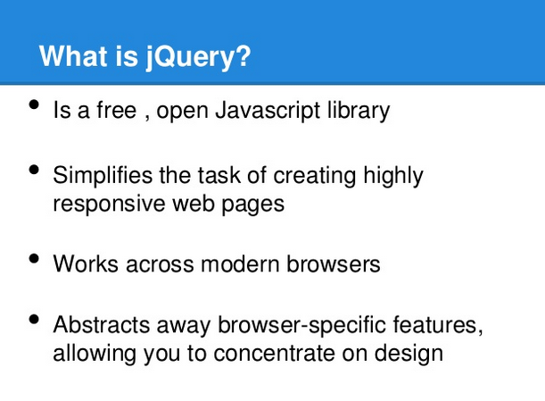

Slide 3
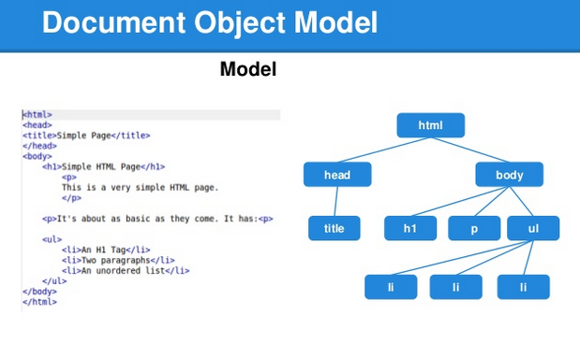

Slide 4
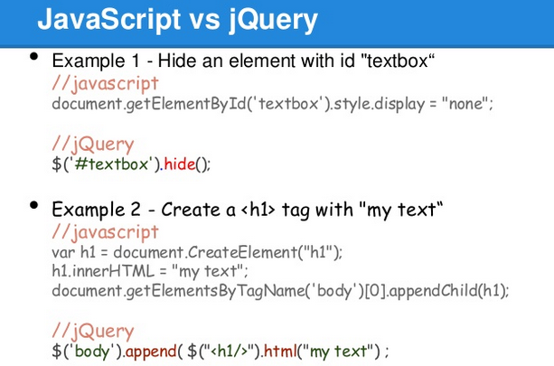

Slide 5
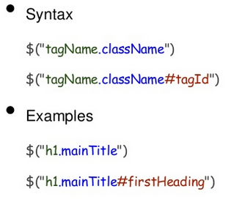
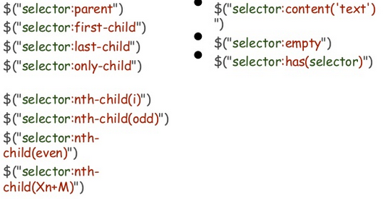
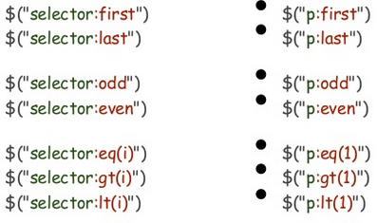
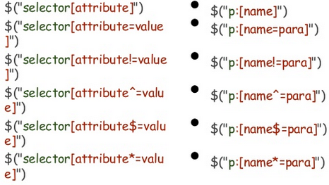
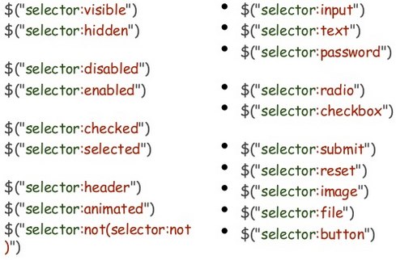
1. Selectors, Combined Selectors
4. Relationship Filters
2. Index Filters
5. Attribute Filters
3. Condition Filters-Form Filters

Slide 6
References
CheatSheets:
https://oscarotero.com/jquery/
https://htmlcheatsheet.com/jquery/
W3Schools:
https://www.w3schools.com/jquery/
https://plnkr.co/edit/?p=catalogue
Official:
https://jquery.com/

